Slide 1

AutoMob-Mechanic Project-1
P1
AutoMob-Mechanic is a web application for an Automobile service/repair company. The application provides different services to get the car repaired or serviced. The user can book a service on their convenient date and then the company representatives will take care of attending to the service request.
Create the below-mentioned HTML pages with listed features:
home.html: For displaying information about the company.
services.html: For displaying services provided by the company.
preventive-maintenance-service.html: For displaying about the preventive maintenance services.
body-repair-service.html: For the displaying about the body repair services.
car-care-service.html: For displaying car care services.
booking.html: For displaying the form to book a particular service.
appointment.html: For displaying the form to schedule an appointment.
booking-success.html: For displaying the confirmation message on booking.

Slide 2
AutoMob-Mechanic Project
P1
Details of the web page(s):
Every page should have a title displayed on the browser tab. Each page has a navigation bar and footer which are separated by a horizontal line. The navigation bar includes below hyperlinks:
AutoMob-Mechanic - Navigates to home.html
Home - Navigates to home.html
Services - Navigates to services.html
Booking - Navigates to booking.html
contact@automob.co.in - Creates a link that opens in the user's email application

Slide 3

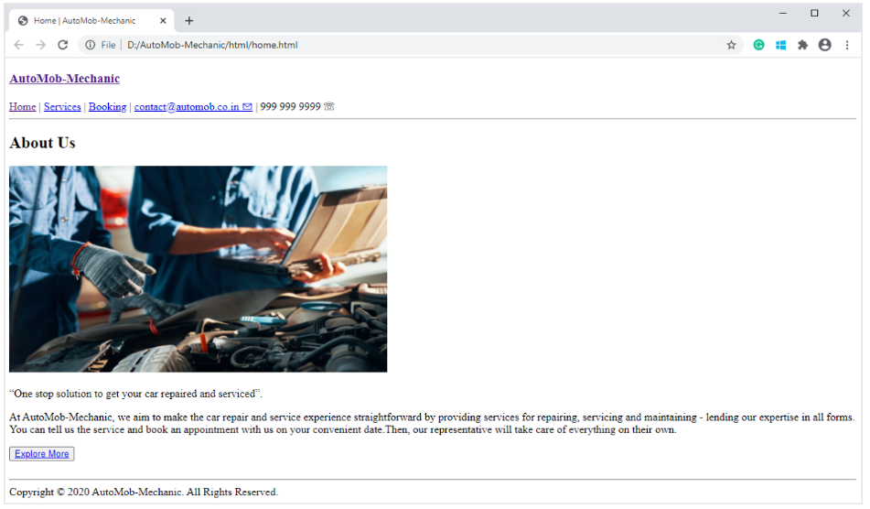
P1
Home.html
1. home.html
This page renders information about the company.
Feature(s) to be implemented:
Use appropriate sectioning element(s) to give meaning to the content
The 'Explore More' button should take the user to services.html.
Screenshot:

Slide 4
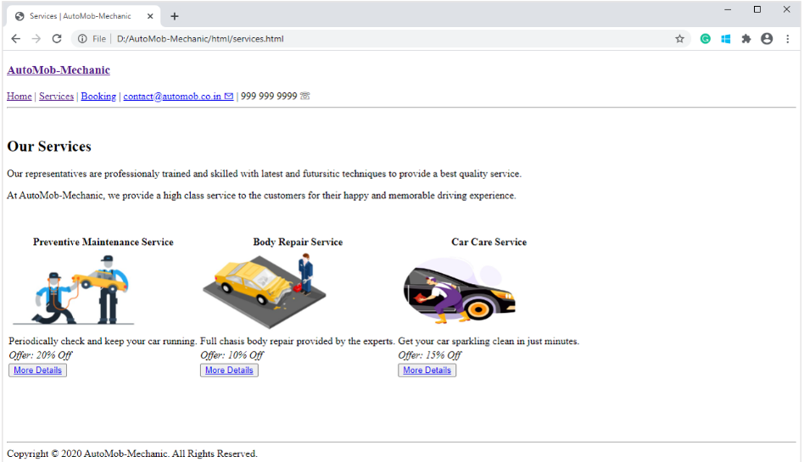
Service.html
P1
2. services.html:
This page displays the list of services provided by the company.
Feature(s) to be implemented:
Use appropriate element(s) to display a table containing details of the services offered.
The 'More Details' button should take the user to the appropriate service page.
Screenshot:

Slide 5
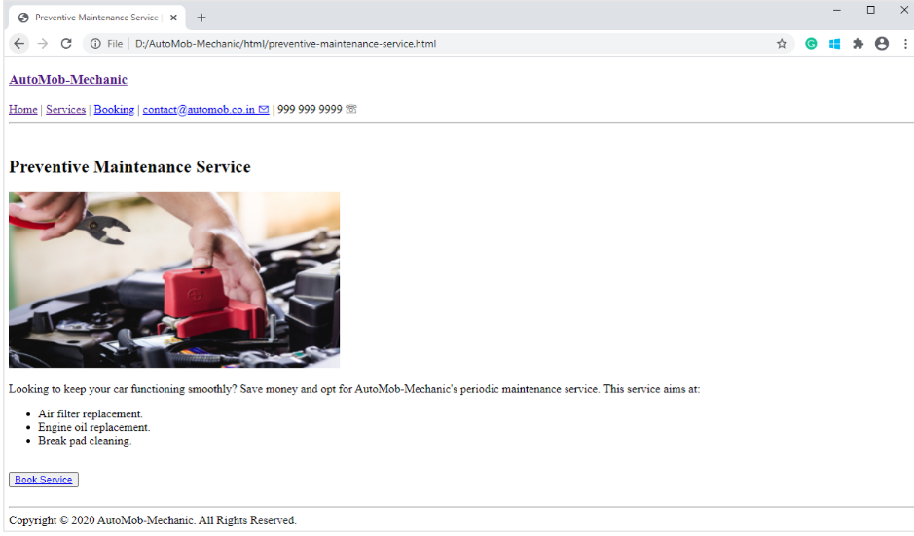
preventive-maintenance-service.html
P1
3. preventive-maintenance-service.html:
This page renders the details about preventive maintenance services.
Feature(s) to be implemented:
Use the appropriate element(s) to display the service aims.
The 'Book Service' button should take the user to the booking.html.
Screenshot:

Slide 6
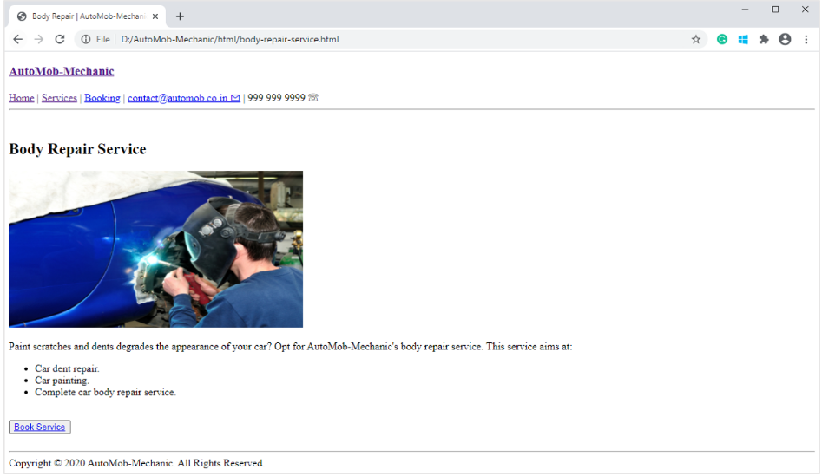
Body-repair-service.html
P1
4. body-repair-service.html:
This page renders the details about body repair services.
Feature(s) to be implemented:
Use the appropriate element(s) to display the service aims.
The 'Book Service' button should take the user to the booking.html.
Screenshot:

Slide 7
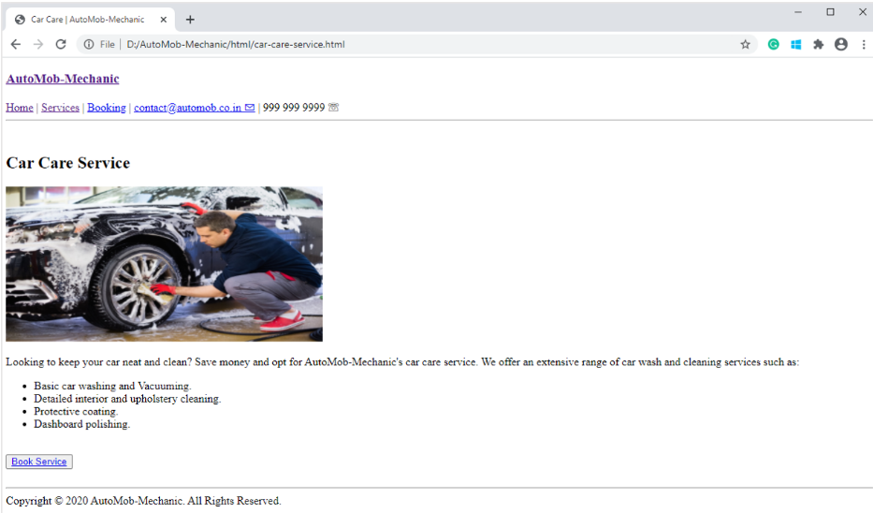
car-care-service.html
P1
5. car-care-service.html
This page renders the details about car care services.
Feature(s) to be implemented:
Use the appropriate element(s) to display the service aims.
The 'Book Service' button should take the user to the booking.html.
Screenshot:

Slide 8
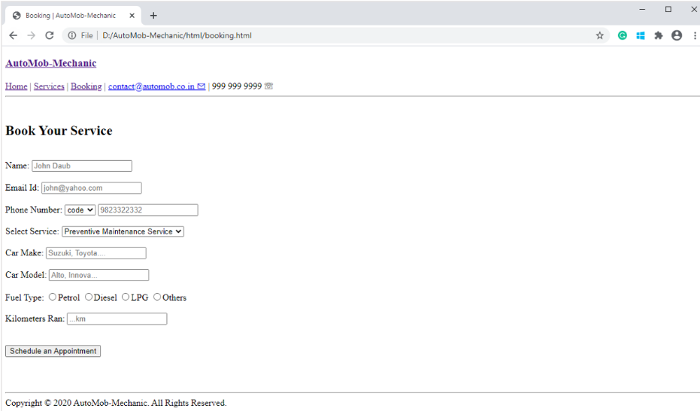
booking.html
P1
6. booking.html:
This page displays a booking form that takes various inputs from the user.
Feature(s) to be implemented:
Use the appropriate element(s) to create a form.
Implement the validations for the form fields.
The 'Schedule an Appointment' button should submit the form to appointment.html using the HTTP method POST.
The form doesn't have an autocomplete feature enabled.
Screenshot:

Slide 9
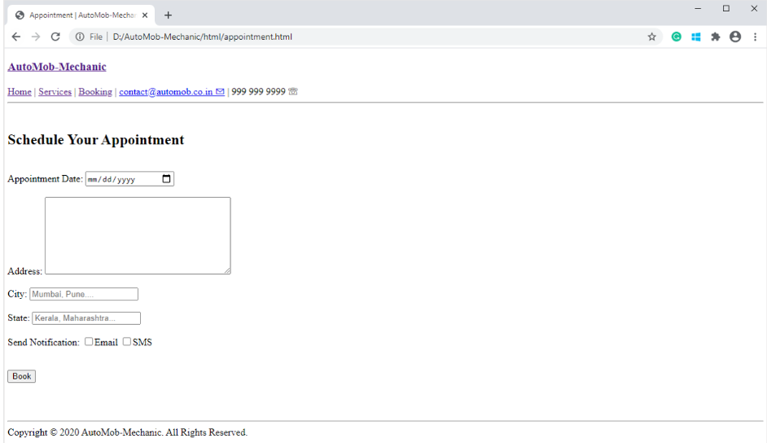
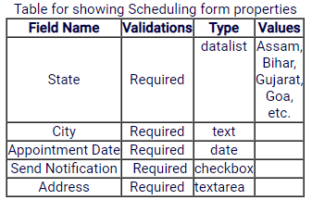
appointment.html
P1
7. appointment.html
This page displays an appointment form that takes various inputs from the user.
Feature(s) to be implemented:
Use the appropriate element(s) to create a form.
Implement the validations for the form fields.
The 'Book' button should submit the form to booking-success.html using the HTTP method POST.
The form doesn't have an autocomplete feature enabled.
Screenshot:

Slide 10
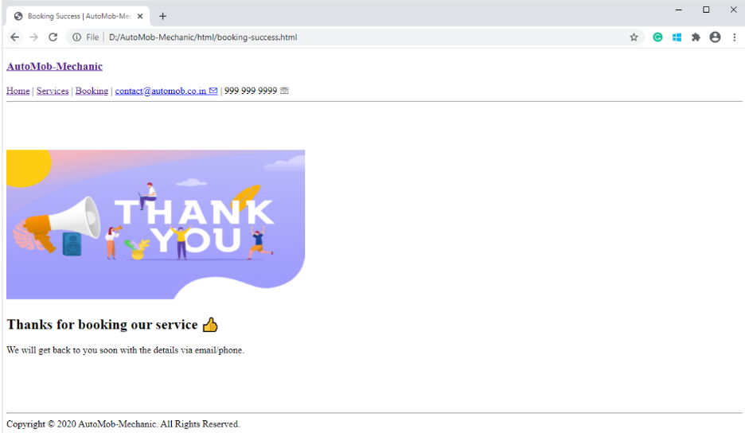
P1
booking-success.html
8. booking-success.html
This page will display a confirmation message once the booking is done.
Screenshot:

Slide 11
P2
Friendship Zone Project-2
Friendship Zone is a web application, where an individual can connect with his/her friends. Refer to the below-listed details for creating a Friendship Zone application.
Create below mentioned HTML page(s) with listed features:
Homepage.html - For displaying Friendship Zone Home page
FriendList.html - For displaying details of people already available at Friendship Zone
RegistrationForm.html - For displaying the form to enroll yourself at Friendship Zone
RegistrationConfirmation.html - For successful registration of the user
RegistrationConfirmationforAdmin.html - For successful registration of admin
Supplied files:

Slide 12
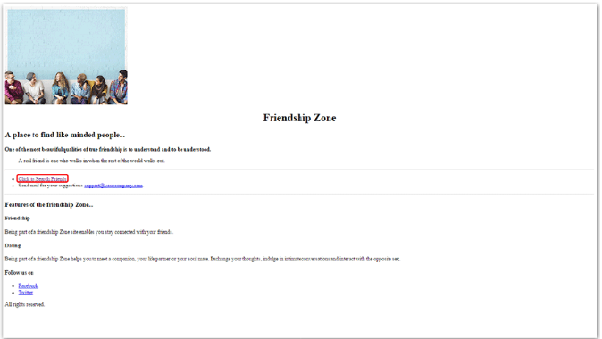
Homepage.html
P2
1. Homepage.html is for displaying Friendship Zone Home.
Features to be implemented:
Use appropriate sectioning element(s) to give meaning to the content
"Click to Search Friends" should take the user to friend-list.html
Use appropriate element(s) to display Facebook and Twitter links
Screenshot

Slide 13
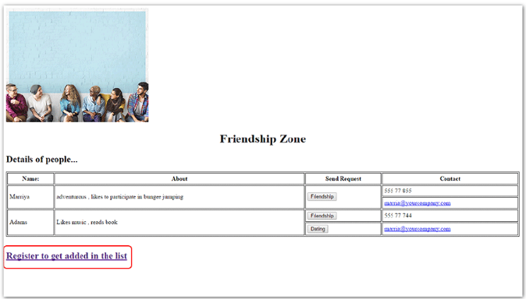
FriendiList.html
P2
2. FriendiList.html is for displaying details of people already available at Friendship Zone.
Feature(s) to be implemented:
Use appropriate element(s) to display a table containing details of people
"Register to get added to the list" should take the user to registration.html
Other links and buttons as mentioned in the screenshot are for display purpose only
Screenshot:

Slide 14
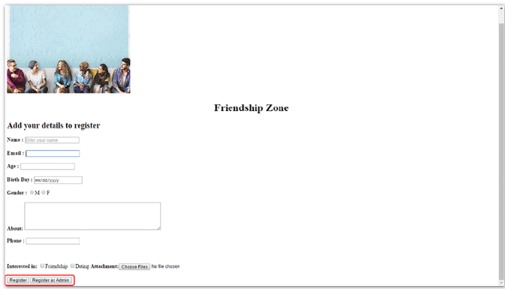
RegistrationForm.html
P2
3. RegistrationForm.html is for displaying the form to enroll yourself at Friendship Zone.
Feature(s) to be implemented:
Use appropriate element(s) to create a form
Implement validations for each form field as mentioned below:
For all other form fields, maintain the look and feel of the application as per the above-given screenshot.
The "Register" button should take the user to RegistrationConfirmation.html, ensuring successful validations for all form fields.
The "Register as Admin" button should take the user to the RegistrationConfirmationforAdmin.html page, irrespective of successful validations.
Registration Confirmation pages for both admin and user should have a link to go back to the Homepage.html page
Screenshot:

Slide 15
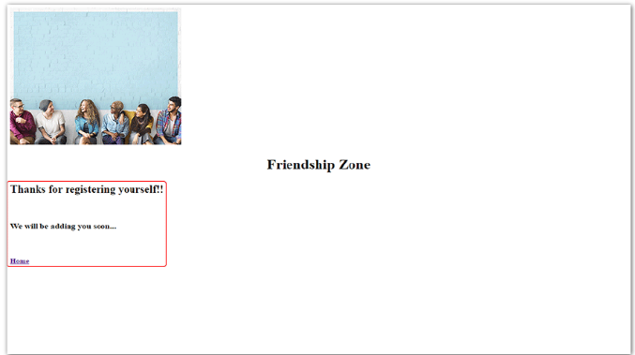
RegistrationConfirmation.html
P2
4. RegistrationConfirmation.html is for the successful registration of a user.
Feature(s) to be implemented:
Display successful registration message to a user
Provide the link to home.html
Screenshot:

Slide 16
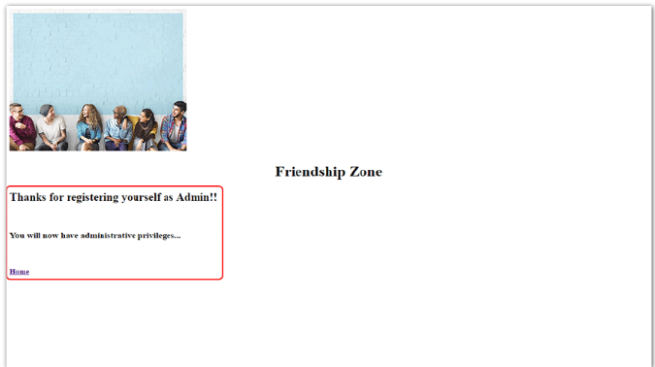
RegistrationConfirmationforAdmin.html
P2
5. RegistrationConfirmationforAdmin.html is for successful registration of admin.
Feature(s) to be implemented:
It should display a successful registration message to the admin
Provide a link to home.html
Screenshot:

